Slide 1
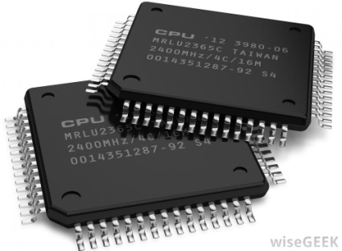

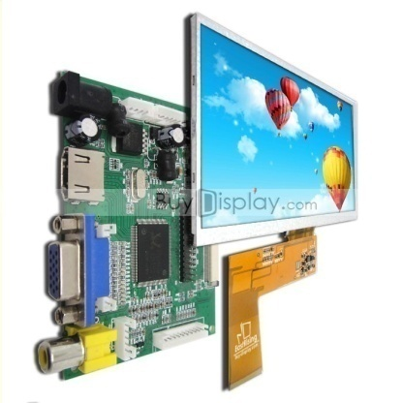
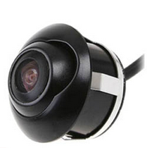
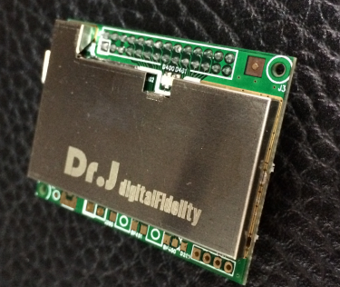
Linux HMI system
JUN.2020
BONKOREA

Slide 2

1. Company Profile
Company Name
BonKorea Co.,Ltd
CEO
TOMA.LEE
Established
May.17th.2010
Address
#C-605A, Indeokwon IT Valley, 40, Imi-ro, Uiwang-si, Gyeonggi-do, Korea
Major products
Solution
CPU : ROCK CHIP
LCD / MEMORY
Car Interface
BSD Solution
GPS IC
GPS ANT
Android Auto Car Play Module
Car DAB Module
©2010-2017 BON KOREA Co.Ltd. – This document is the intellectual property of BON KOREA and contains confidential information. All reproduction and communication to third parties is strictly prohibited without prior written consent from BON KOREA
Total Multimedia solution leader BON KOREA

Slide 3
2. Milestone(2010-Now)
2011~2012
2015~2016
2018
2020
2011.July. Developed DMB Module(Small size) and supply in Telcom smart NAVI
2012.Jan. Developed GPS module and supply in NAVI market
2015.Dec. Developed Interface Board
2016.Dec. Developed Android CPU Module
Development of IOT Equipment with Farming
and Fishing Village Corporation
Korea Distributor agreement for HMI Development kits of FlyThings
2011~2012
2015~2016
2018
2020
2010
2014
2017
2019
2010
2014
2017
2019
May. Established BON KOREA Co.,Ltd
Nov. Supply in LCD NAVI market
Supplied DTV BOX
to Japanese FCA
ROCK CHIP SOLUTION
CAMERA MODULE
CAR AMP & DMB MODULE
DAB + BT SPEAKER
LCD Display Launch for Navi and Kitchen TV
- Navi : 7”, 8”
- Kitchen TV : 10.1”, 11.6”, 13.3”
©2010-2017 BON KOREA Co.Ltd. – This document is the intellectual property of BON KOREA and contains confidential information. All reproduction and communication to third parties is strictly prohibited without prior written consent from BON KOREA
Total Multimedia solution leader BON KOREA

Slide 4
Introduction of Linux HMI display platform
More than multimedia.
And better connected.
A social machine for creating your lifestyle collections.
We specialize in human-computer interaction solutions for embedded device terminals. Providing hardware, systems, and HMI development kits for customers in various industries to help reduce the input cost and development time of embedded human-computer interaction in various industries. It is our goal to make our customers' products available to the market quickly and steadily.

Slide 5
Platform introduction
01
Linux
GUI
IDE
Core system
Modernization
WISWIG
FlyThIngs operating system
2.5 sec
3 sec
The FlyThIngs OS is based on Linux system, excellent performance, Autonomous GUI framework, PC development function, debugging tool chain. Make industry application development more efficient and achieve faster product launching.
Starting speed
Download debugging

Slide 6
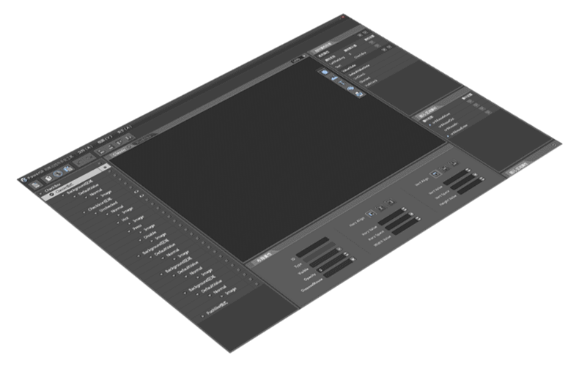
Multi-level GUI framework
The system is based on a multi-level UI structure design, and each control is completed by a separate image or color matching resource. Allow multi-window layer overlay,

Slide 7
02
Technical Platform Framework
APP
FTU Loader
MQTT
HTTP
HTTPS
It's perfect on Linux.
ZKloader : fast boot and encrypted boot
Add init, properties framework
GUI frame
Hardware related API, such as GPIO, IIC.
Multimedia framework, also binding hardware layer
Network Interface API, WIFI Set API
Hardware API
Media
API
Controls
GUI Core
init
Properties
net
Linux Kernel
ZKLoader

Slide 8
03
Solution Introduction
Z11s
Z6s
Up to 1.2GHz operating speed based on ARM Cortex-A7
64MByte DDR2 more cool human interaction
Built-in RTC, perpetual calendar function
Based on ARM926EJS@ 600MHz
32MByte DDR
Ultra low cost, full color display solution
System
FastGUI
ARM FlyThings OS IoT Intelligent Operating System
Start up to 1.5 seconds, stable operation
Support APP independent update, file system
Fast GUI launch, Android-like human interaction
Based on 2D engine rendering, the effect is smooth and realistic
Support vector graphics, png graphics, better display
IDE
Source development
WYSIWYG interface development
Support png,.9, vector font, etc., the display effect is completely consistent with Android
C, C + source development page logic
Easily port all kinds of open source code
Easy access to all types of third-party resources

Slide 9
03
Platform selection
 | Z11s | Z6s | Z6 | A33
CPU | ARM Cortex-A7 1.0GHz | ARM926 600MHz | ARM926 600MHz | ARM Cortex-A7*4 MaliMP2
DDR | DDR2 64MB | DRAM 32MB | DRAM 64MB | DDDR3 128M/512M
Display | 1024*768 RGB | 800*600 RGB | 1280*800 RGB | 1280*800 RGB,LVDS,MIPI
Video in | USB/MIPI/DVP | NA | CVBS/DVP | USB/MIPI
Network | WiFi+以太网+4G | WiFi+4G | WiFi+4G | WiFi,BT,4G, Ethernet
connectivity | 2*UART+5*GPIO+1*ADC(MUX)+1*IIC（MUX） | 3UART+8*GPIO+4*ADC（MUX）+1*IIC（MUX） | 3UART+8*GPIO+4*ADC（MUX）+1*IIC（MUX） | UART*6+ADC+GPIO
Package | LPFQ128 | QFN88 | QFN88 | Core board
Multimedia | H.264En/Decode@1080P+audio en/decode | Only audio decoding is supported | Audio decoding + common format video decoding @1080P | Audio decoding + common format video decoding @1080P

Slide 10
03
Drag and drop control design
WYSIWYG
Quick design method for copying, moving, aligning, etc.
UI Design
Based on Eclipse development environment
Code completion, prompt, index, check
Support C, C++ source development
Support so library, .a library compilation
Development tool
Source development
Development tool is a WYSIWYG interface development tool and a dedicated development kit for HMI modules. The tool can quickly complete the design of the software interface by dragging the controls
Automatically generate template code
Integrated build tool chain without compiling with a Linux host
Integrated USB debugging function, direct download and debug
Integrated USB log output function, file management function
Other characteristics

Slide 11
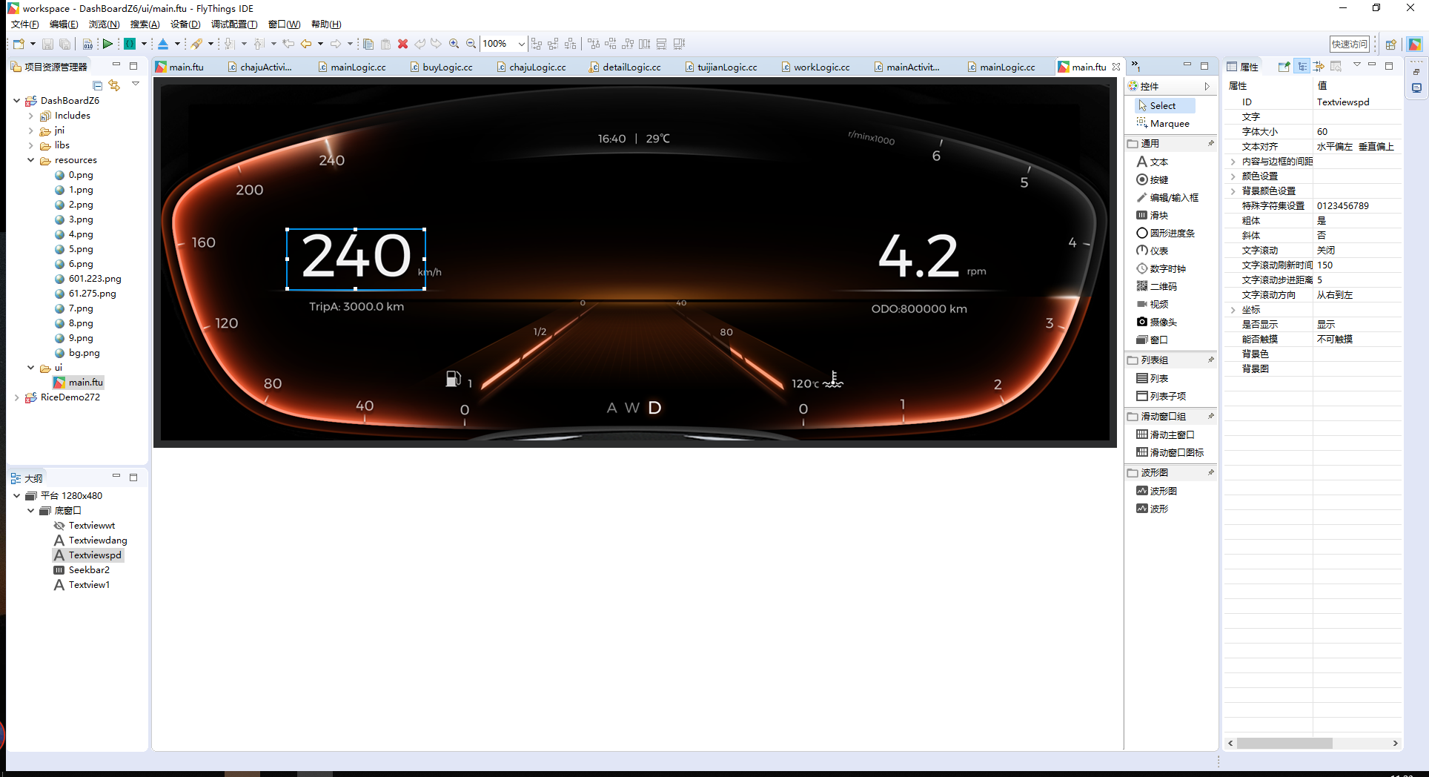
03
Development tool IDE

Slide 12
04
HMI Solution features
Low cost
GUI effect
Stability
Technical Services
As low as 32MB of DDR configuration, cool UI interactions no longer require strong hardware support. Hardware costs are reduced by more than 30%.
Self-developed Fast GUI, a combination of fast and cool
Support language switching
Support theme switching
Based on open source Linux, stable and efficient
Support multi-tasking, fully compatible with POSIX1.0 standard
The most widely used operating system
Ten years of Linux system development and GUI development. Provide strong technical support for product development

Slide 13
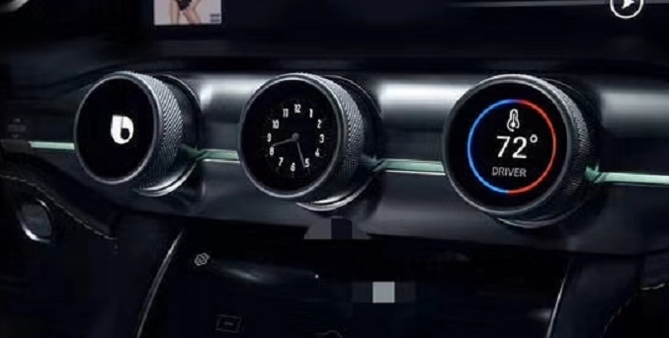
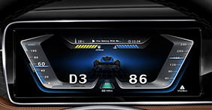
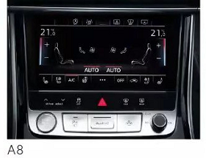
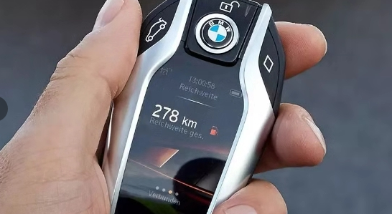
05
Application - Automotive Electronics
Air conditioning information screen
Low speed electric vehicle instrument
Air conditioning controller
smart key

Slide 14
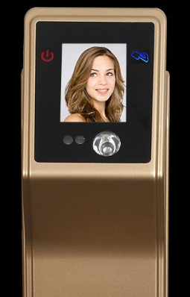
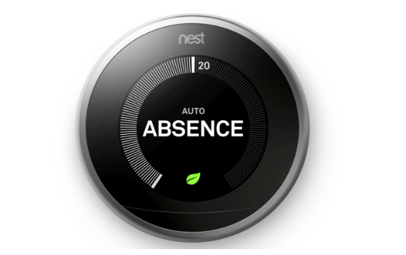
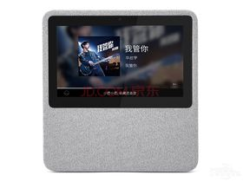
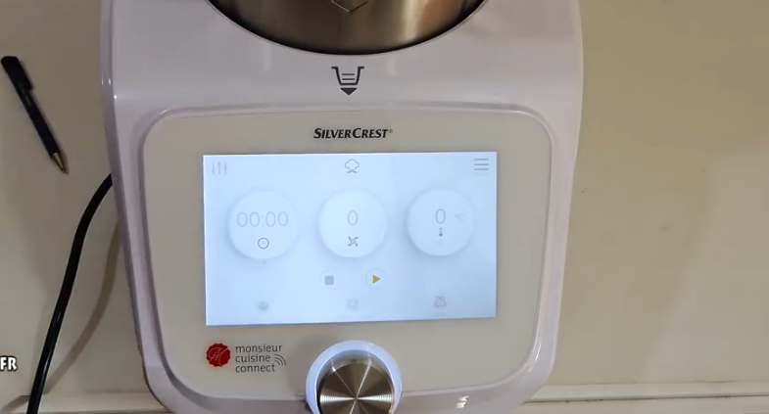
05
Application - smart home
Thermostat
Smart door lock
Smart speaker
Smart chef machine

Slide 15
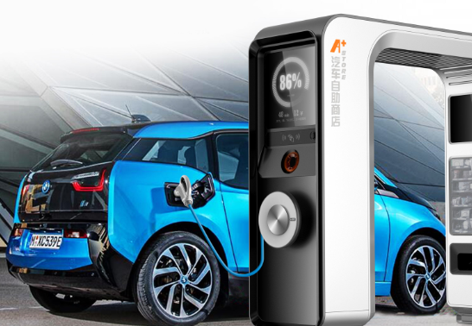
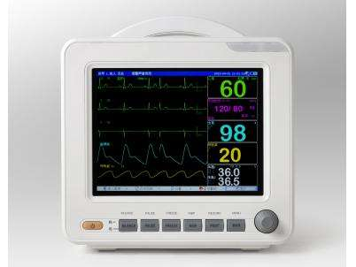
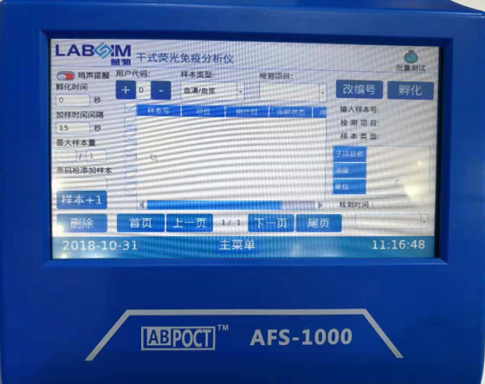
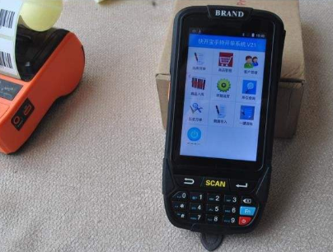
05
Application--Medical Industrial Control
Monitor
Charging pile
Analytical Instruments
Handheld PDA

Slide 16
06
Cooperation model
Hardware module
Open BOM
System authorization
Custom Development
For simple scenario requirements, users with less than 20K per year are recommended to use standard hardware module design.
For users with large usage and hardware PCB structure requirements
Software licensing services for proprietary industries such as cars, speakers, AI vision recognition
Support customized hardware platform based on current design, development tool oriented development cooperation

Slide 17
Proposal for Coway display controller
More than multimedia.
And better connected.
A social machine for creating your lifestyle collections.

Slide 18

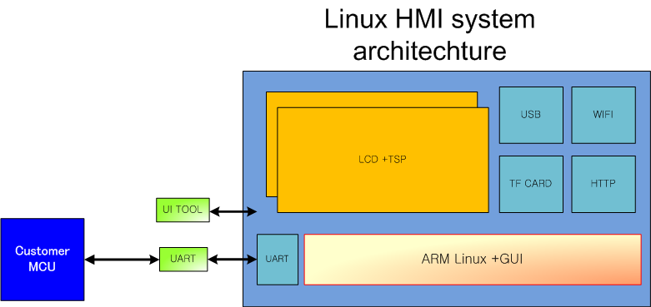
HMI system introduction
Configuration
ARM 926 EJS 600 MHz : Allwinner F1C100s custom made
DDR : 32 MB DDR 1
UART : 2
TFCard : 1
SPIFLASH : Norflash, SPI NAND
USB 2.0 OTG
Screen interface : RGB 666 / I 80, maximum support to 1280 * 800 resolution
Other interface : built-in RTP, Codec, audio decoder, video decoder, TVIN
F1C100s

Slide 19
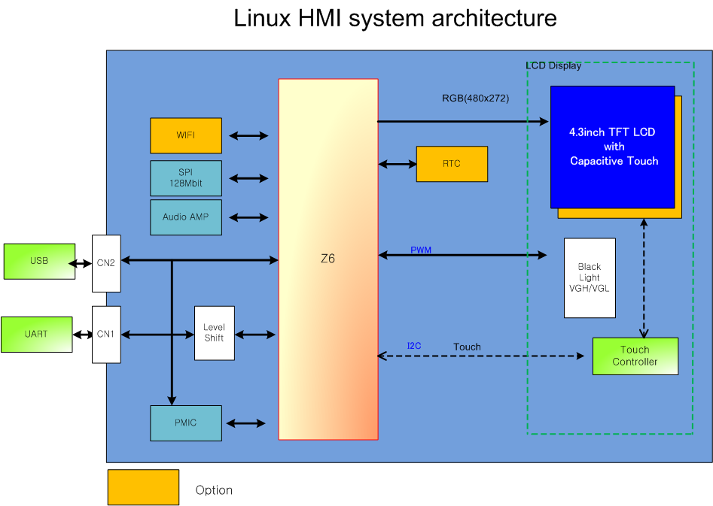
HMI system architecture
Requirement
Communication : UART@5V TTL level
Speed : 115200bps
Protocol : See the reference document
Display : 4.3 TFT LCD
Resolution :480 x 272
Working data : UI message, Key message, time message, etc….
Power : 5V
Command from coway MCU

Slide 20
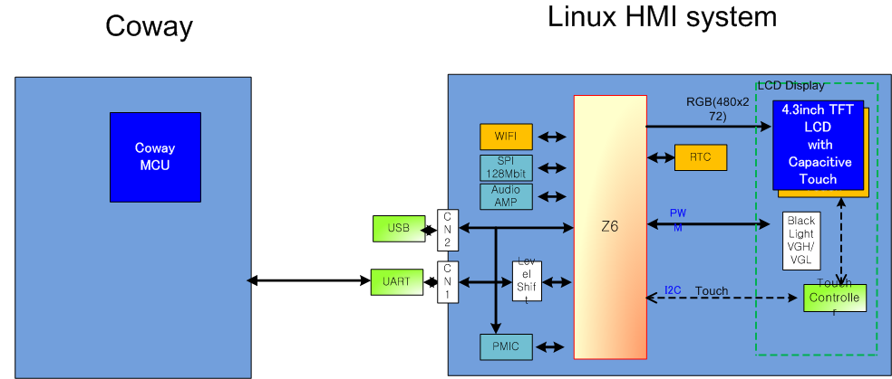
Coway HMI system architechture

Slide 21
System descryption
 | HMI full function | Coway HMI
AP | Z6s(F1C100s) | Z6s(F1C100s)
Core | ARM9 | ARM9
Memory | 32MB | 32MB
SPI Memory | 128Mbit | 128Mbit
OS | Linux | Linux
TF Card | Yes | Yes
USB | Yes for ADB | Yes for ADB
UART | Yes | Yes
RTC | Yes | Option
WIFI | Yes | Option
LCD | IPS 4.3inch | IPS 4.3inch
CTP | Yes | Option
External 1
External 2 | Power(5V)

Slide 22
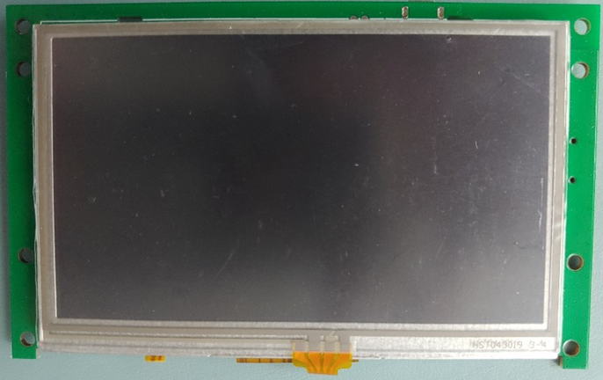
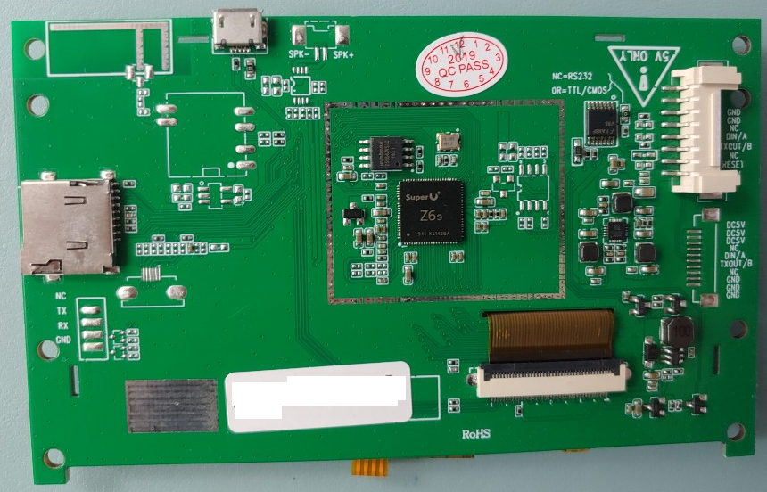
첨부
Sample 제품 사진
기본 사양 : Z6s + LCD(480x272) + RTP
제품 Size : 122.3x75x12[mm]
(최대 높이 12[mm] : LCD+RTP+PCB+Connector)

Slide 23
We can do it
Thank you
BONKOREA

